Slide 1
Presentation Notes
This entire deck, including demos but not the checkpoints, must be delivered in 10 minutes or less. Participants need time to do the actual lab.
Talking points are very brief. Even if you’ve seen the same slide in the past, take note of the new talking points.

Slide 3
Mobile DevOps 1 Cross Platform Mobile Development with Xamarin
Code Labs

Slide 4
Mobile DevOps Modules
1
Cross Platform Mobile Development with Xamarin
2
Continuous Integration using Visual Studio Team Services for Cross Platform Mobile Apps
3
Continuous Delivery for Cross-Platform Mobile Apps using Visual Studio Team Services and HockeyApp

Slide 5

Mobile Development Trends
Native technologies
Native cross-platform
Device capabilities & perf
Silos per platform
Device capabilities & perf
Multi-platforms
Web technologies
Hybrid applications
Web standards based
Limited device access
Device capabilities
Limited perf
Notes:
Native technologies – Xcode, Android

Slide 6






Visual Studio / Visual Studio Code with Windows Phone & Android emulators
Mobile web
Hybrid apps
Native and cross-platform
Native apps with C++
Notes:
Say “Fully-featured, extensible IDE for building mobile apps for any target platform
and Multi-channel (Web, mobile, APIs) and any architectural approach”
Points to hit:
Visual Studio provides devs with:
1. Smooth, simple acquisition process
2. VS is a platform that accelerates the ability for developers to build apps
Web
Hybrid capabilities
Native and close-to-native capabilities through Xamarin, C++ (shared libraries)
Games with Unity
3. VS provides you with a fully-featured extensible IDE for any platform allowing you to author, debug, build & test all from VS to all platforms
4. Re-use your skills and even assets when building apps
Together this all means a great development environment that maintains a tight, iterative loop with author, debug and test all from within Visual Studio, to all platforms.

Slide 7
Visual Studio/Visual Studio Code with Windows Phone & Android emulators
Native and cross-platform
Mobile web
Hybrid apps
Native and cross-platform
Native apps with C++
Notes:
Say “Fully-featured, extensible IDE for building mobile apps for any target platform
and Multi-channel (Web, mobile, APIs) and any architectural approach”
Points to hit:
Visual Studio provides devs with:
1. Smooth, simple acquisition process
2. VS is a platform that accelerates the ability for developers to build apps
Web
Hybrid capabilities
Native and close-to-native capabilities through Xamarin, C++ (shared libraries)
Games with Unity
3. VS provides you with a fully-featured extensible IDE for any platform allowing you to author, debug, build & test all from VS to all platforms
4. Re-use your skills and even assets when building apps
Together this all means a great development environment that maintains a tight, iterative loop with author, debug and test all from within Visual Studio, to all platforms.

Slide 8


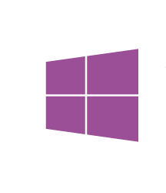

C# cross-platform mobile: .NET + Xamarin
Native & Cross-Platform Mobile with C#
Share app logic across platforms
Native apps for Windows, iOS and Android devices using C#
Maximize code shared with Portable Class Libraries
Leverage existing C# skills
100% platforms’ APIs exposed
z
Native UI
Native UI
Native UI
C# + XIB
C# + AXML
C# + XAML
Shared
client app C# logic
“Anything you can do in Objective-C, Swift, or Java can be done in C# and Visual Studio with Xamarin”
Notes:
With C# (.NET + Xamarin) you can build native and cross-platform apps targeting iOS, Android and Windows.
Points to hit:
- You can leverage existing C# skills
You can share code across platforms
You get Native UI and performance
100% API support: Anything you can do in Objective-C, Swift, or Java can be done in C# and Visual Studio with Xamarin

Slide 9












Team Build (CI)
Test & Code Coverage
apk
Release
Management
with Approvals
git push
Bug Tracking
HockeyApp
Crash Reports
& Feedback
apk
UWP
Debugging in Visual Studio
Unit Test
HockeyApp
Update Manager
Emulator
apk
Simulator

Slide 10
Module 1
Visual Studio
Xamarin
Debugging
Unit Testing
Team Build (CI)
Test & Code Coverage
apk
Release
Management
with Approvals
git push
Bug Tracking
HockeyApp
Crash Reports
& Feedback
apk
UWP
Debugging in Visual Studio
Unit Test
HockeyApp
Update Manager
Emulator
apk
Simulator

Slide 11
Lab Module1-Xamarin

Slide 12
Module Exercises
Signing up for a Xamarin Account
Exploring Xamarin Projects in Visual Studio
Compiling the HealthClinic.Biz Xamarin Solution
Creating a VSTS Team Project
Pushing the Source Code to the VSTS Team Project
Running Unit Tests

Slide 13
Wrap Up
Signed up for a Xamarin Account
Explored Xamarin Projects in Visual Studio
Opened the HealthClinic.Biz Xamarin Solution
Created a VSTS Team Project
Pushed the Source Code to the VSTS Team Project
Run and understood Unit Tests

Slide 14

Checkpoint
Notes:
Time: TBD

Slide 15
Wrap Up
Notes:
Time: TBD

Slide 16
Call to Action
B836 Cross-platform Mobile with Xamarin
B835 Cross-platform Mobile with Apache Cordova
B869 Mobile DevOps with HockeyApp and Visual Studio Team Services
Re-visit Build on Channel 9.
Continue your education at Microsoft Virtual Academy online.
Notes:
Share Your Story for Challenge Points Speaker Notes:
Given that the next speaker will typically need access to your room right after your talk we recommend you encourage everyone to form up around the flash voting sign for the 3 minute feedback activity, and to then stick around to chat with you right after. This approach will benefit participants who want to speak with you after the talk but who are also interested in participating in the feedback activity.
Emphasize that the attendees who participate in flash voting about their work, in depth feedback sessions, or registering for future opportunities will get //build Challenge Points for doing these activities. Encourage them to swing by the Visual Studio: Share Your Story booth to get more details about additional Challenge Point opportunities.

Slide 17
Share Your Story for Challenge Points
Give us 3 minutes of feedback about your work right after this session at the Flash Voting sign
Join in on 15-30 minutes in depth feedback sessions at the Visual Studio: Share Your Story booth
Register in 2 minutes for Visual Studio feedback opportunities after build at http://aka.ms/devtodev
Notes:
Share Your Story for Challenge Points Speaker Notes:
Given that the next speaker will typically need access to your room right after your talk we recommend you encourage everyone to form up around the flash voting sign for the 3 minute feedback activity, and to then stick around to chat with you right after. This approach will benefit participants who want to speak with you after the talk but who are also interested in participating in the feedback activity.
Emphasize that the attendees who participate in flash voting about their work, in depth feedback sessions, or registering for future opportunities will get //build Challenge Points for doing these activities. Encourage them to swing by the Visual Studio: Share Your Story booth to get more details about additional Challenge Point opportunities.

Slide 18
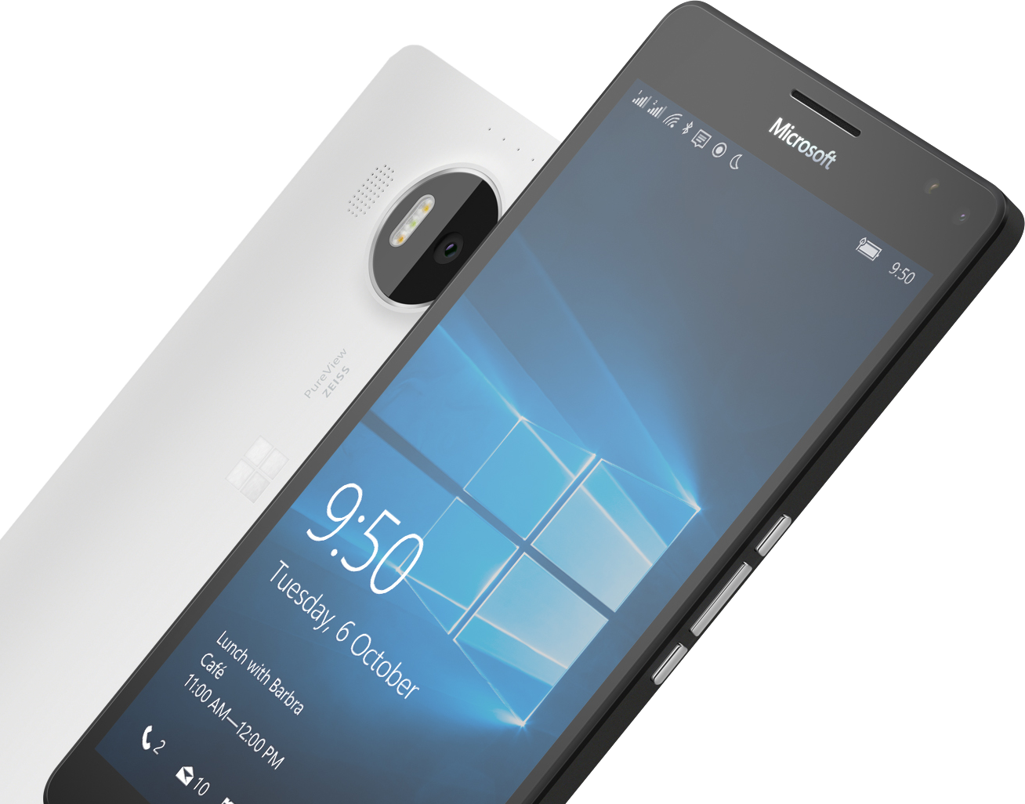
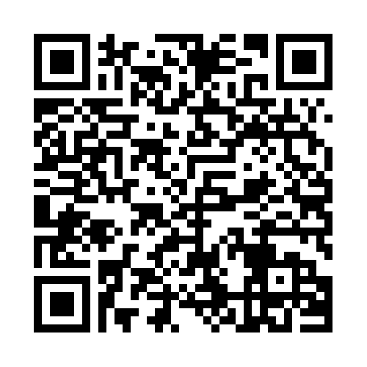

Please Complete An Evaluation Form Your input is important!
Required Slide
*delete this box when your slide is finalized
SAMPLE
or
Notes:
Update phone image to a Microsoft phone.

